Slide 1
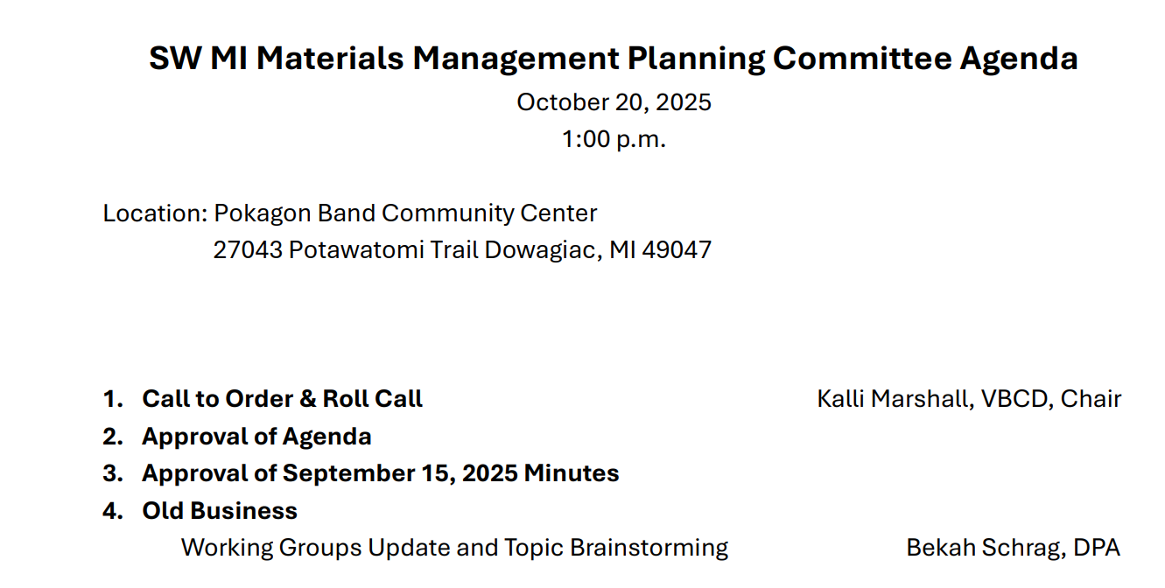

Slide 2
Working Groups
Education – First Monday 3-4pm
Monday November 3: 3-4pm
Cass County – Second Monday 11-12pm
Monday November 10: 11-12pm
Van Buren County – Second Wednesday 9-10am
Wednesday November 12: 9-10am
Berrien County – Second Wednesday 11-12pm
Wednesday November 12: 11-12pm
Policy – Third Thursday 12-1pm
Thursday November 20: 12-1pm

Slide 3
Working Groups - MMPC Members
Education
Amy Huser
Cass County
John Egelhaaf
Van Buren County
Kalli Marshall
Berrien County
Adam Brent
Policy
Roseann Marchetti

Slide 4
What topics would you like the working groups to explore?
Education
Education and outreach programming
Policy
Siting
County
Additional goals
Funding mechanisms
Enforcement mechanisms
Ordinances
Implementation
Educational opportunities

Slide 5

Recycling Goal Review
1
Divert Various Materials from the Landfill and Track Diversion Rates
2
Build a Culture of Recycling and Waste Reduction Through Education, Engagement, and Outreach
3
Expand and Improve Recycling Infrastructure and Access
4
Implement Policies and Funding Mechanisms to Support Recycling

Slide 6



Do not edit
How to change the design
What goals, objectives, or actions are missing from the Recycling Goals?
The Slido app must be installed on every computer you’re presenting from

Slide 7
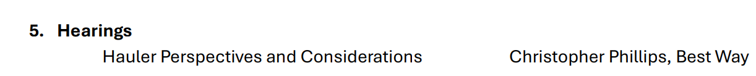

Slide 8
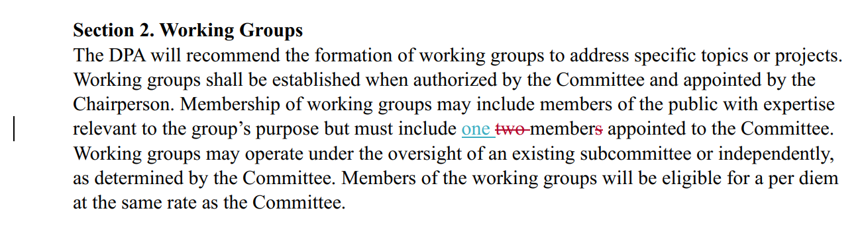
Bylaws Update

Slide 9
