Slide 1
Michigan Materials Management Planning Recycling Goals

Slide 2
WHY
Michigan EGLE has set the Benchmark Recycling Standards each County will need to meet to comply with PA 115.
Notes:
11 drop off Waste and Recycling stations through out the county
Owned by individuel municipalities

Slide 3
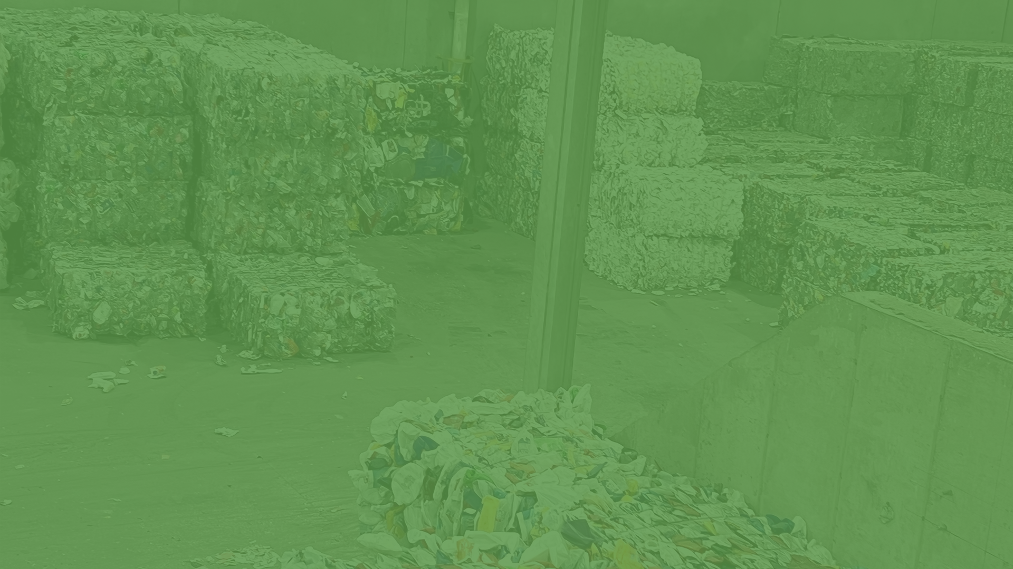
Best Practices

Slide 4
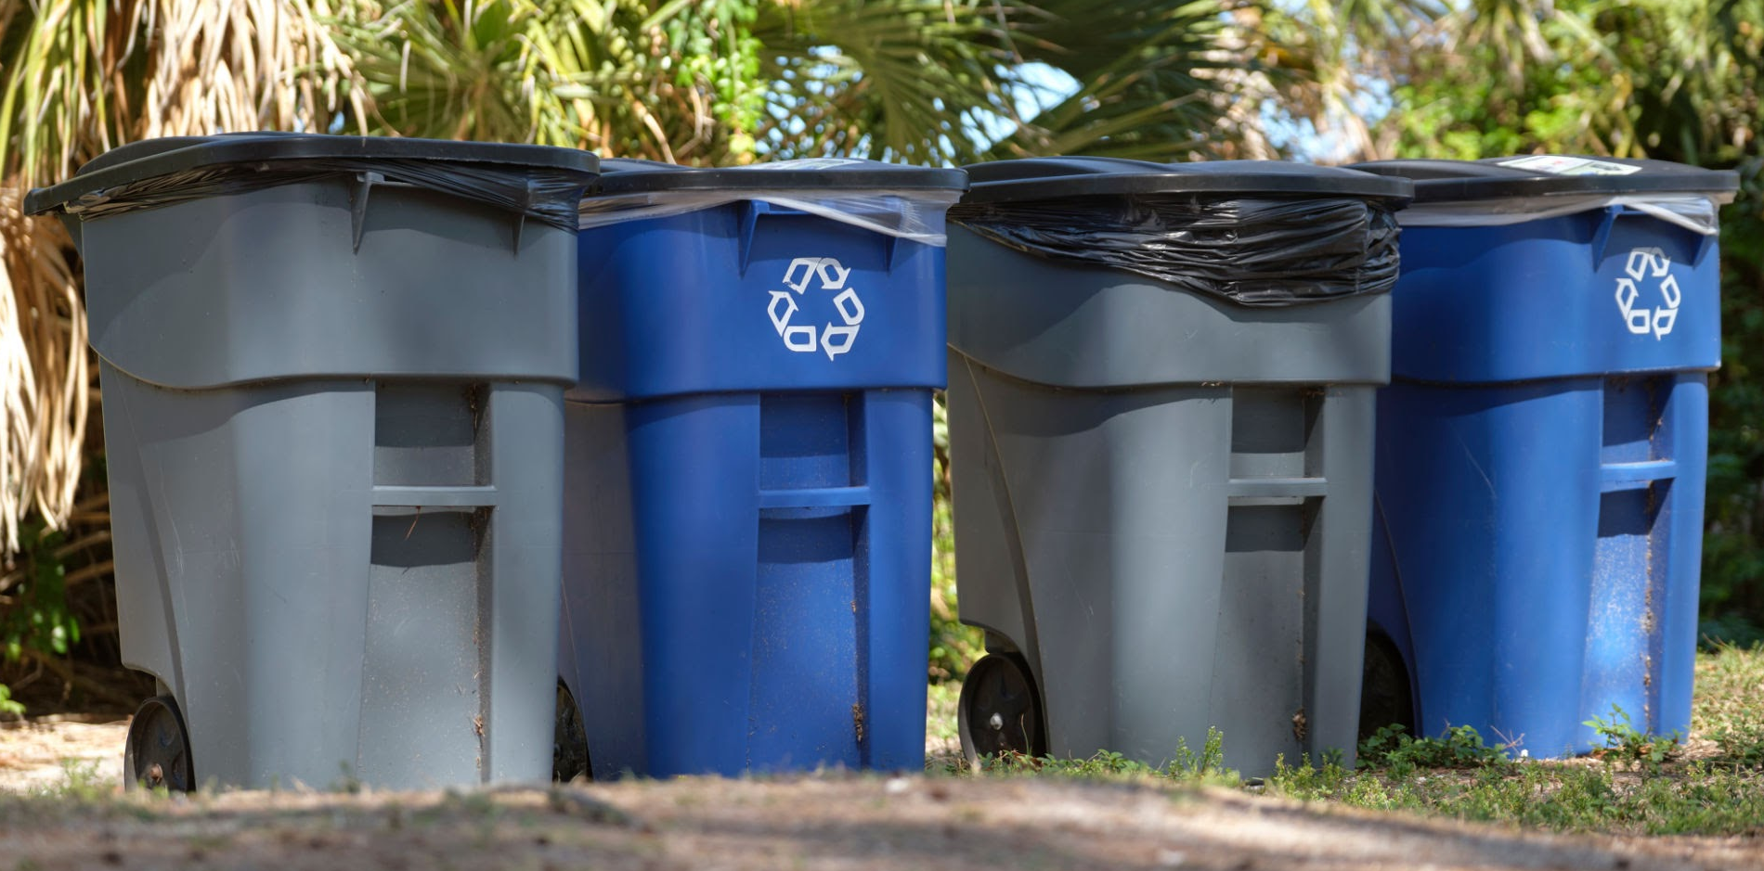
CURBSIDE RECYCLING PROGRAMS
Curbside Carts
Hauling Contracts
Have a maintenance plan for contamination
Make sure all residents have access, which means everyone in the community has a cart
Institute a recurring annual recycling budget

Slide 5
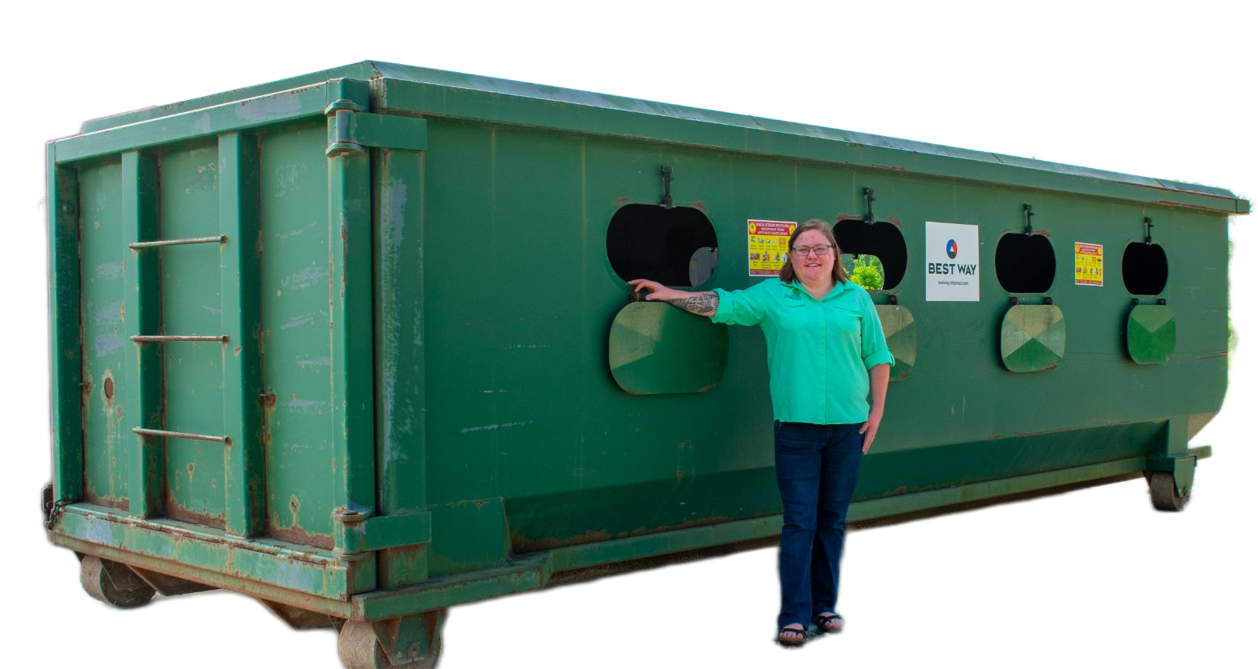
DROP-OFF RECYCLING PROGRAMS
Add clear signage at your drop-off locations
Location is everything
Contamination management:
  Staffed
  Fenced
  Cameras
  Anti litter ordinance posted
Adequate collection containers:
  Collection capacity
  Contamination from weather
  Bulk item, Etc.

Slide 6
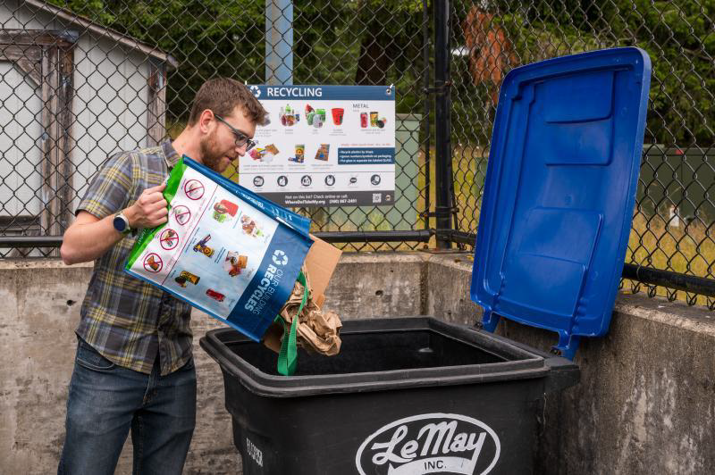
MULTI-FAMILY RECYCLING PROGRAMS
Consider a multi-family recycling ordinance
  Ex. City of Ferndale
Engage EARLY & OFTEN with property owners, management companies, service providers & tenants
  Consider diverse populations & transcreating materials
*Access & infrastructure may look different for each housing structure

Slide 7
Goal Ideas

Slide 8
SCHOOL RECYCLING PROGRAMS
Contracting for district level solid waste service and recycling
Establish Green Teams to improve engagement and participation
Waste Audits to establish a baseline and understand needs/cost savings
Curriculum to educate about and encourage participation
Infrastructure to support collection
  Classroom containers for paper, bottles, and cans
  Cafeteria containers for recycling, food waste, or food rescue "share table"
Low/Zero Waste school events
  Reusables in the classroom and cafeteria
  Recycling and sporting events

Slide 9


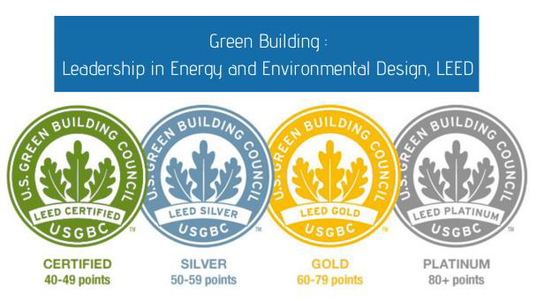

COMMERCIAL RECYCLING PROGRAMS
Explore sustainability certifications and market to companies

